Slide 1
RAUWOLFIA SERPENTINA

Slide 2
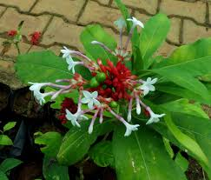

Slide 3
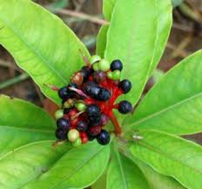

Slide 4
Common name – Indian snakeroot, Sarpagandha in Sanskrit
Family- Apocynaceae
DESCRIPTION
A small shrub - smooth leaves - pink or white blooms - long, tapering
Snake like roots, found throughout India, Burma, Pakistan, Thailand, Africa etc.
Introduced in homoeopathy by Dr. W. Templeton

Slide 5
HABITAT
It grows well in hot humid climate, with a temperature between 10-38 degree Celsius.
Evergreen shrub growing up to 1 metre tall from a yellowish rootstock.
It is a source of compounds that are used in the pharmaceutical industry.

Slide 6
HISTORY
Serpentina was selected for study due to its long, tapering, snake-like roots.
The Indian political leader Mahatma Gandhi was known to employ Rauwolfia, using the root to make a tea that he consumed in the evening to help relax after a busy, overstimulated day.

Slide 7
It contains at least 20 alkaloids of which reserpine, rauwolscine, alstonine, yohimbine, serpentinine, raubasine, raupine, reserpinine, ajmalcine, ranucscine, iso-raunescine, serpine are well known.
serpentine and ajmaline alkaloid -they lower blood pressure.
Serpentinine alkaloid raise blood pressure and is a powerful central stimulant.

Slide 8
Primary action of reserpine alkaloid is to deplete the catecholamine serotonin content, especially in the brain, adrenal medulla, heart, and blood vessels.
Reserpine is absorbed from the intestine. It is metabolized in the liver and its products are slowly excreted.(The reserpine content has been found to be highest in the root and lower in the stems and leaves)

Slide 9
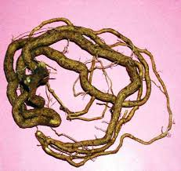

Slide 10
Reserpine is widely distributed throughout the body to the brain liver, spleen, kidney, and adipose tissue.
Other studies have shown that reserpine is also widely distributed to red blood cells and peripheral neurons.
It has been found to be present in breast milk and to cross the placenta and blood-brain barrier.

Slide 11
RESEARCH PART
In 1952, Vida in Germany reported a blood pressure drop in 25 patients with hypertension.
Arnold and Bach showed a good response in 37 of 50 patients in whom systolic pressure dropped an average of 30 mm Hg and diastolic pressure dropped 15 mm Hg.

Slide 12
MEDICAL USES
Used for the treatment of mental diseases, including schizophrenia and bipolar disorder, epilepsy and sleep problems.
Rauwolfia has been studied as a treatment for autistic children between the ages of 3 to 9 years.

Slide 13
Another study found it to be effective in treatment of delirium tremens in alcohol and drug addicted patients. The researchers in that study observed a noted decrease in agitation, excitement, and acute hallucinatory episodes.

Slide 14
In the Indian system of medicine ,it was used for epilepsy, insanity, insomnia, dysentery, diarrhoea, cholera, headache, blindness, a wide variety of fevers.
Antidote for insect bites and snakes bites.
It has been very popularly used in insanity, hypertension, and certain neuropsychiatric disorders etc.

Slide 15
It’s juice is helpful in treatment of opacity of cornea.
The wood which is known as serpentwood is used as woodcarving

Slide 16
One study found that Rauwolfia treated migraine headaches effectively, with a noted improvement in quality of life and a decrease in pain.
Another study used Rauwolfia to treat angina pectoris in patients with coronary artery disease, finding a decrease in angina symptoms and a prolonged therapeutic effect.

Slide 17
SIDE EFFECTS
Adverse side effects of reserpine include lethargy, sedation, psychiatric depression, hypotension, nausea, vomiting, abdominal cramping, gastric ulceration, nightmares, bradycardia, angina-like symptoms, bronchospasm, skin rash.
After several months of use, mental depression can occur and may persist.

Slide 18
With extremely large doses, Parkinson-like symptoms, extrapyramidal reactions, and convulsions can occur.
Pregnancy and breast-feeding: The chemicals in Indian snakeroot can pass into breast milk and might harm a nursing infant.
Gall stones: Indian snakeroot might make gallbladder disease worse.

Slide 19
Stomach ulcers, intestinal ulcers, or ulcerative colitis: Don't use Indian snakeroot if you have ever had one of these conditions.
DOSAGE
Take 5 to 10 drops of tincture twice daily in the beginning.
Reduce the dose as symptoms improve.

Slide 20
THANK YOU ALL….

